Slide 1
PATTERN RECOGNITION Topic - Hail Predictor
Presented by- Submitted to-
- Nikhil Matta - Mr. Subhashish Goswami
- Rohit Kala

Slide 2
MACHINE LEARNING (ML)
ML is a branch of artificial intelligence:
- Uses computing based systems to make sense out of data
- Extracting patterns, fitting data to functions, classifying data, etc.
- ML systems can learn and improve
- With historical data, time and experience
- Bridges theoretical computer science and real noise data.

Slide 3
MACHINE LEARNING AS A PROCESS
Define Objectives
Data Preparation
Model Building
Model Deployment
Model Evaluation
- Define measurable and quantifiable goals
- Use this stage to learn about the problem
- Normalization
- Transformation
- Missing Values
- Outliers
Study models accuracy
- Work better than the naïve
approach or previous system
Do the results make sense in the context of the problem
- Data Splitting
Features Engineering
Estimating Performance
Evaluation and Model Selection

Slide 4
HAIL PREDICTOR - ABSTRACT
Hail (snow/rain storm) causes billions of dollars in losses by damaging buildings, vehicles, and crops.
Improving the spatial and temporal accuracy of hail forecasts would allow people to mitigate hail damage.
Machine learning models, like decision tree is used to predict whether there will be hail storm or rain.

Slide 5
INTRODUCTION
Hail, or large spherical ice precipitation produced by thunderstorms, has caused billions of dollars in losses by damaging buildings, vehicles, and crops.
Economic losses from hail have been increasing over the past two decades as populations have increased and cities have expanded in the hail-prone regions.
Some losses from hail could be mitigated with accurate prediction or forecasts of severe hail potential that give people and companies time to protect vehicles and property from an incoming hailstorm.

Slide 6
OBJECTIVES
Study the previous collected data/observation of hail storm.
Feature selection by implementing various graphs.
Train a portion of the data (training data set) based on different input parameters.
Optimize the model’s complexity and validation of data.
Evaluate a batch of data by testing it after training on a different batch of data.

Slide 7
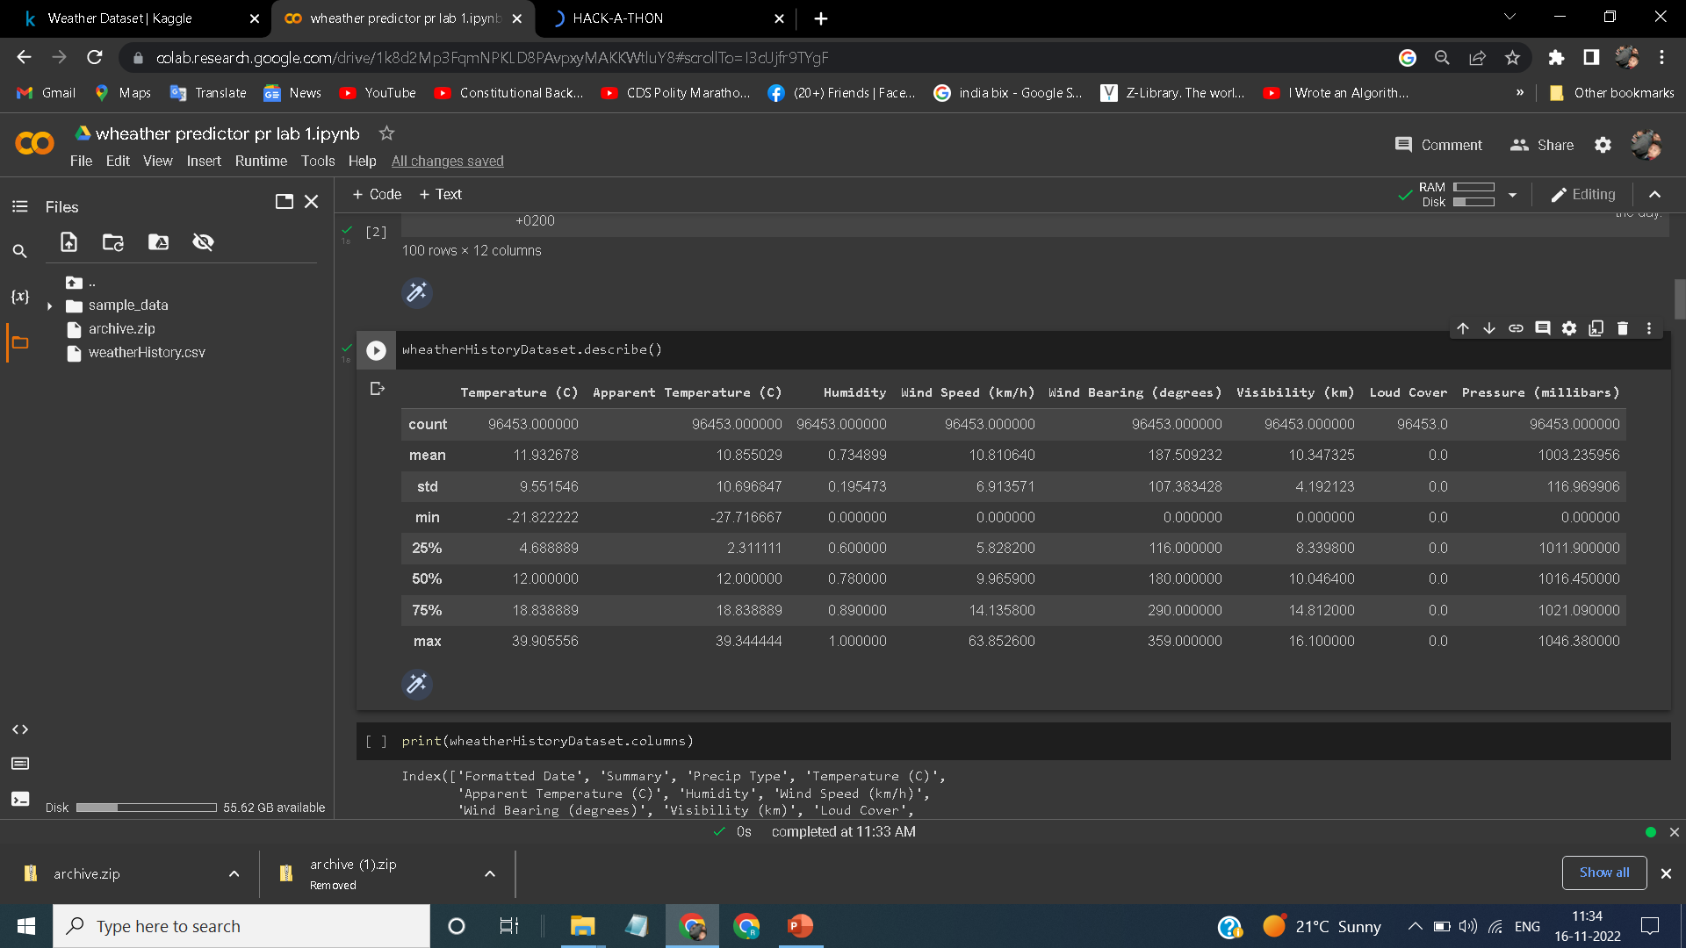
Dataset
Number of Rows: 96453
Number of Columns: 12

Slide 8
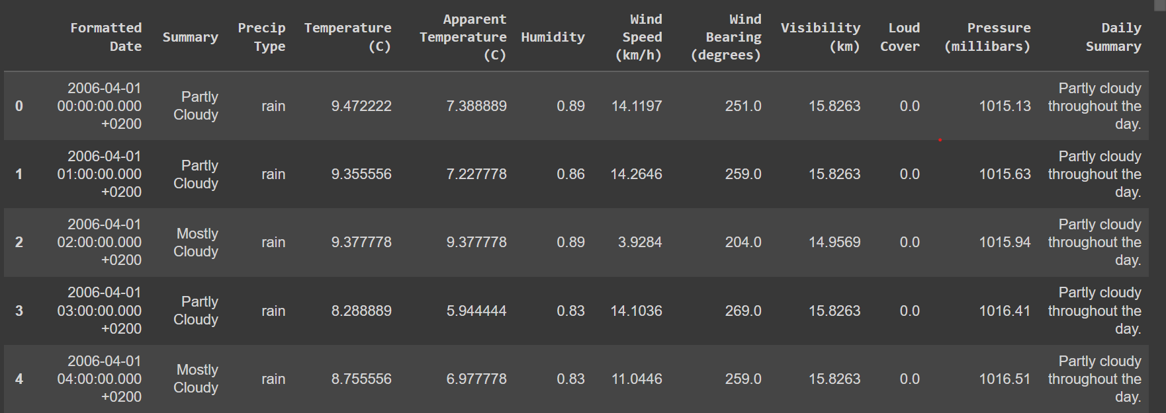
https://www.kaggle.com/datasets/muthuj7/weather-dataset?resource=download

Slide 9
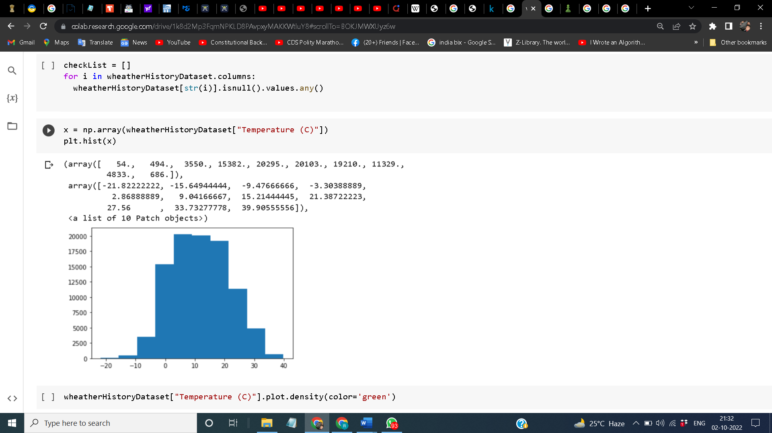
Histogram
X-axis - Temperature
Y-axis - Values.

Slide 10
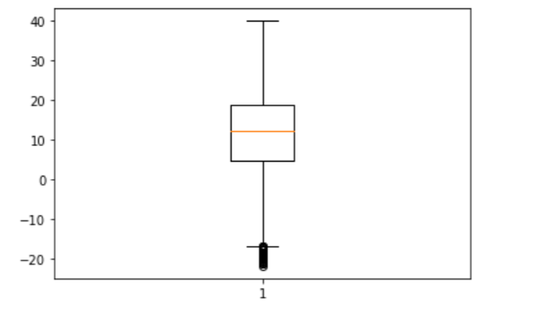
Boxplot Graph
These are the Outliers

Slide 11
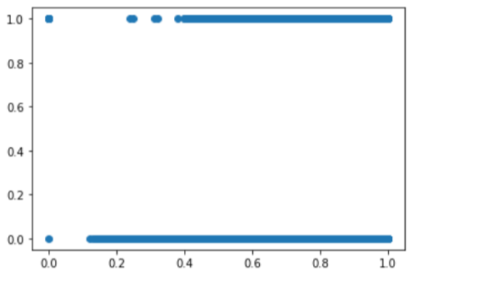
Scatter Plot
Plot between “Humidity” and “Precip type.”

Slide 12
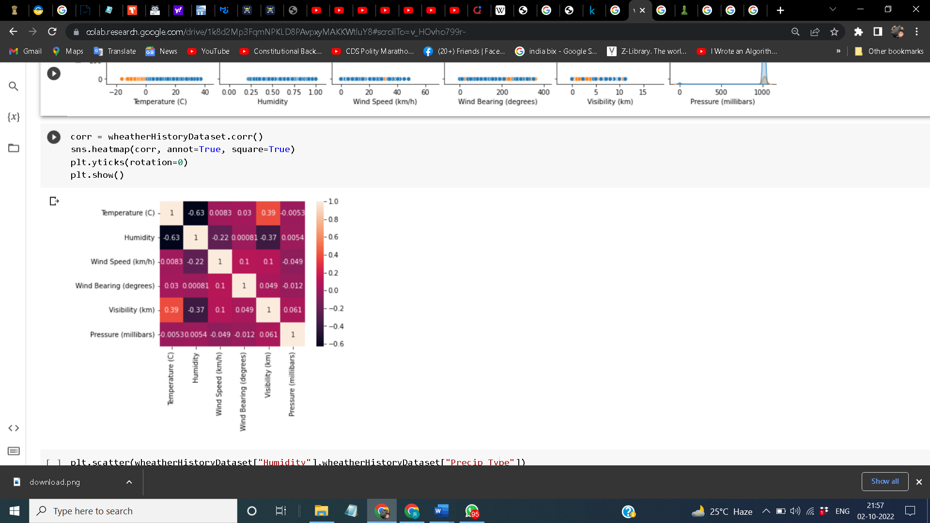
Heat-Map

Slide 13
Decision Tree
A Decision tree is a flowchart-like tree structure, where each internal node denotes a test on an attribute, each branch represents an outcome of the test, and each leaf node (terminal node) holds a class label.
Gini Index is the evaluation metrics we shall use to evaluate our Decision Tree Model.

Slide 14
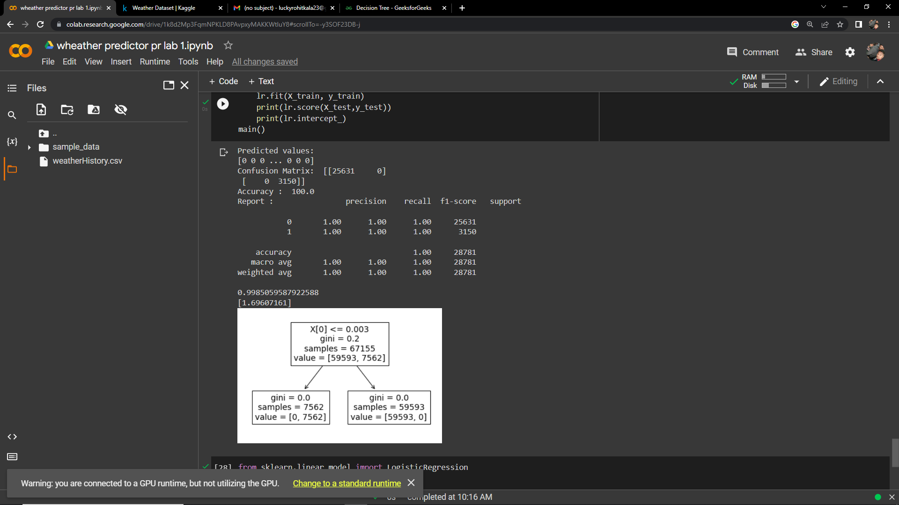
Decision Tree Classifier

Slide 15





Result

Slide 16
References
https://www.kaggle.com/datasets/muthuj7/weather-dataset?resource=download

